Slide 1
Introduction to Java

Slide 2
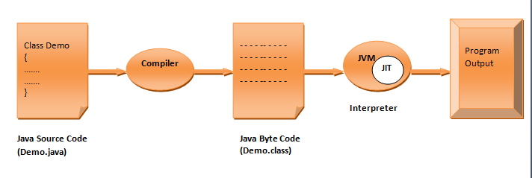
Java Introduction and History
Java is an Object Oriented programming language developed by James Gosling and his team in 1991 at Sun Microsystems. Initially it was called Oak but later in 1995 changed to Java.
In 2010: Oracle Corporation acquired Sun Microsystems, taking over Java development. Oracle continued to evolve Java with major releases and improvements.
Java is compiled and interpreted language –
Fig: java compilation and interpretation process

Slide 3
First of all compiler converts the java source code into a form called Byte Code. This is a file with .class extension and this Byte Code is called platform independent.
This Byte Code is interpreted by Java Virtual Machine (JVM) into executable code. Because JVM is available for almost every available device that's why Java is called platform independent language.
And this Byte Code also provides the security as well as portability to java language.
As java is compiled and interpreted language so one may think that its execution speed is slow than other compiled languages like C or C++. But there is not much difference because Byte Code is highly optimized and JVM can execute it much faster than you think.
Also JVM contain a JIT (Just In Time) compiler. JIT in place of compiling the whole program, compiles only that part of the program that is needed at that time.

Slide 4
How Java came into existence
The primary motivation for developing the Java was to develop a platform independent language that can be used to create software's for consumer electronic devices like TVs, Microwave Oven, Remote control etc.
The reason behind this is that as different devices makes use of different types of controller so languages like C and C++ etc are not efficient for these types of software development because to run the software we need to design a full version of compiler for these languages for different types of devices available.
This is very time consuming and not an efficient solution.
Java provides efficient solution to this as java is platform independent i.e. can run on any device only we need JVM interpreter for that device.
After some time James Gosling and his team member realize that the same problem that java was initially designed to solve on a small scale could also be applied to the internet on large scale.
So they changed focus from consumer electronic devices to internet programming. And now it has been widely used in this field also.

Slide 5
Key Features of Java
Platform Independence: Achieved through the use of the JVM and bytecode.
Object-Oriented Programming: Built on OOP principles, making it modular and reusable.
Security: Provided a secure execution environment.
Robustness: Included features like garbage collection to manage memory efficiently.

Slide 6
Applications of Java
Web Development
Used for building dynamic, secure, and scalable websites.
Frameworks: Spring, Hibernate, Servlets, JSP.
Mobile Development
Primary language for Android app development.
Tools: Android SDK, Java APIs.
Enterprise Applications
Large-scale business applications (e.g., CRM, ERP).
Java EE (Enterprise Edition) and Spring.
Software Development
Used to build desktop applications (e.g., GUI applications using Swing or JavaFX).
Scientific Applications
Java’s robustness is ideal for complex simulations, modeling, and scientific computing.
Big Data Technologies
Java is used in frameworks like Hadoop for processing large datasets.
Embedded Systems
Used in smart devices and IoT due to its platform independence.
Cloud Computing
Java is used for building cloud-based applications and services (e.g., Amazon Web Services, Google Cloud).

Slide 7
What is JDK?
The Java Development Kit (JDK) is a software development kit used to develop Java applications. It includes:
Java Runtime Environment (JRE): Provides the libraries and Java Virtual Machine (JVM) necessary to run Java programs.
Development Tools: Includes tools like the Java compiler (javac), Java debugger (jdb), and other utilities to develop and run Java programs.
In short, the JDK provides everything you need to write, compile, and run Java applications.

Slide 8
Setting Up JDK on Windows
To write your first Java program on Windows, you need to install the JDK and set up the environment variables so that you can run Java from the command line.
Steps to Install and Set Path for JDK in Windows:
1 – Download JDK – Go to -https://www.oracle.com/technetwork/java/javase/downloads/index.html
Choose the appropriate version for Windows (e.g., .exe for Windows)
2 - Install JDK:
Run the downloaded installer and follow the on-screen instructions.
By default, it installs in C:\Program Files\Java\jdk-version.

Slide 9
3 - Set the Path in Windows:
Step 1: Open the Start Menu and search for "Environment Variables".
Step 2: Click on Edit the system environment variables.
Step 3: In the System Properties window, click on the Environment Variables button.
Step 4: Under System Variables, find the variable Path and click Edit.
Step 5: Click New, and add the following paths (replace jdk-version with the actual version number):
C:\Program Files\Java\jdk-version\bin (this is the path to the Java executable files).
Optionally, add the JAVA_HOME variable:
Click New under System Variables and set:
Variable name: JAVA_HOME
Variable value: C:\Program Files\Java\jdk-version
Step 6: Click OK to save and close all windows.

Slide 10
4 - Verify the Installation:
Open Command Prompt (cmd).
Type the following commands to check if Java is installed and the path is correctly set:
java -version
javac -version
You should see the Java version information for both the java runtime and the javac compiler.

Slide 11
Hello World Program
Open the Notepad and write the following program -
class Demo
{
public static void main(String args[])
{
System.out.println("Hello World");
}
}

Slide 12
1. class Demo -
class: This keyword is used to define a class in Java. A class is a blueprint for creating objects (instances), and it encapsulates data and methods.
Demo: This is the name of the class. In Java, class names conventionally start with a capital letter, although it’s not a strict rule.
So, class Demo is declaring a class named Demo. Everything between the curly braces { } is part of this class.

Slide 13
2 - public static void main(String args[])
public: This is an access modifier that makes the main method accessible from anywhere. The main method is public because it needs to be accessible to the Java runtime environment to start the program.
static: This means that the main method belongs to the class itself rather than instances of the class. This is important because Java needs to call this method without creating an object of the class.
void: The main method does not return any value, so the return type is void. This means that it doesn’t give anything back after execution.
main: This is the entry point for any Java application. When you run a Java program, the JVM (Java Virtual Machine) looks for the main method to start executing the code.
String args[]: This is the parameter for the main method. It's an array of String objects, which can be used to pass command-line arguments to the program.
For example, if you run your program from the command line like this: java Demo arg1 arg2, the args array would contain {"arg1", "arg2"}.
Together, public static void main(String args[]) is the standard signature of the main method in Java, and it's the starting point of execution for the program.

Slide 14
3 - System.out.println("Hello World");
System: This is a built-in class in the java.lang package that provides access to system resources. It has several useful methods, including System.out, which is used for output.
out: This is a static field of the System class, and it's an instance of the PrintStream class. It represents the standard output stream, which, by default, is the console (or terminal).
println: This is a method of PrintStream. It prints the argument provided (in this case, "Hello World") followed by a newline. This means it will display the string on the console and then move the cursor to the next line.
"Hello World": This is a string literal that you want to print to the console.
So, System.out.println("Hello World"); will display Hello World on the console and then move to the next line.

Slide 15
Putting It All Together:
When you run this program, the main method is executed first because it is the entry point of the program.
The statement System.out.println("Hello World"); is then executed, which prints the string Hello World on the screen.
After printing, the program finishes execution because there are no more statements to execute.

Slide 16
Compiling and Executing the Program -
In java compilation and execution take place as follows –
Save the file - Save this program with the name of class i.e Demo.java(Note - extension should be .java) at desired location (in our case we are saving in C drive in a folder named Programs). It is not always necessary to save the program file with name of class. However if class is public then there is compulsion that file name should be the same as class name.

Slide 17
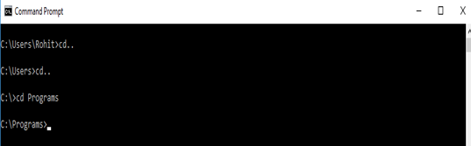
Now open command prompt by writing cmd in search box or run box. First of all we need to go to the location where program is saved (i.e Programs folder in C drive) as shown below-
Compilation - The name of compiler for java is javac. Compile program by writing the following command - javac Demo.java
Now press enter key. If there is no error then compiler will create a Demo.class file at the same location where your program is stored.

Slide 18
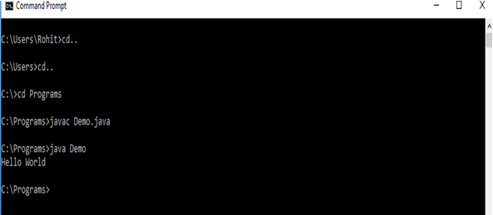
Interpretation - After compiling we need to interpret Demo.class file. The interpreter of java is java. Write the following command to interpret program - java Demo
Now press the enter key and output will be displayed on the screen as shown below –

